Slide 1

Learning Objectives
LO1 Prepare the heading of a work sheet.
LO2 Prepare the trial balance section of a work sheet.
© 2014 Cengage Learning. All Rights Reserved.

Slide 2
Consistent Reporting
Lesson 6-1
LO1
The accounting concept Consistent Reporting is applied when the same accounting procedures are followed in the same way in each accounting period.

Slide 3
Fiscal Periods
Lesson 6-1
LO1
The length of time for which a business summarizes its financial information and reports its financial performance is called a fiscal period.
A fiscal period is also known as an accounting period.
A fiscal period consisting of twelve consecutive months is called a fiscal year.

Slide 4
Work Sheet
Lesson 6-1
LO1
A columnar accounting form used to summarize the general ledger information needed to prepare financial statements is called a work sheet.

Slide 5
Reasons Accountants Use a Work Sheet
Lesson 6-1
LO3
Summarize general ledger account balances to prove that debits equal credits
Plan needed changes to general ledger accounts to bring account balances up to date
Separate general ledger account balances according to the financial statements to be prepared
Calculate the amount of net income or net loss for a fiscal period

Slide 6
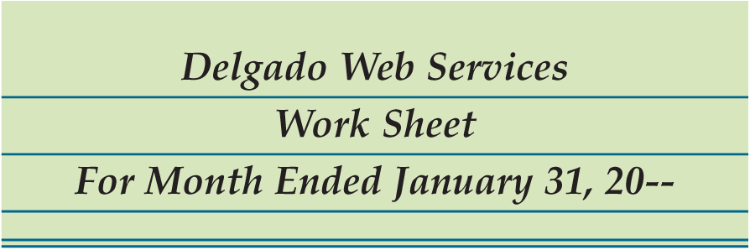
Preparing the Heading of a Work Sheet
Lesson 6-1
LO1
1
Name of Company
2
Name of Report
3
Date of Report

Slide 7
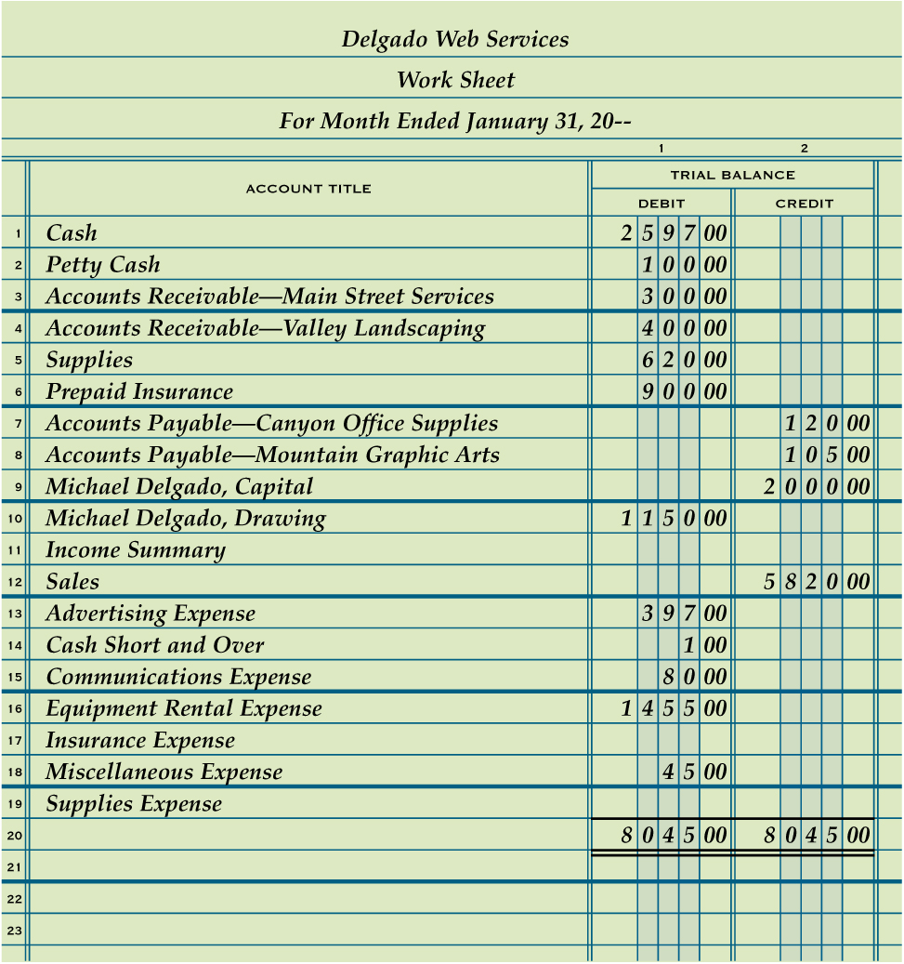
Preparing a Trial Balance on a Work Sheet
Lesson 6-1
LO2
2
1. Write the general ledger account titles in the work sheet’s Account Title column.
2. Write the general ledger debit account balances in the Trial Balance Debit column. Write the general ledger credit account balances in the Trial Balance Credit column.
1
3. Rule a single line across the two Trial Balance columns below the last line on which an account title is written.
4. Add both the Trial Balance Debit and Credit columns.
3
5. Write each column’s total below the single line.
4
6
6. Rule double lines across both Trial Balance columns.
5

Slide 8

Lesson 6-1 Audit Your Understanding
Lesson 6-1
1. What is written on the three-line heading on a work sheet?
ANSWER
Name of the business, name of report, and date of report

Slide 9
Lesson 6-1 Audit Your Understanding
Lesson 6-1
2. Which general ledger accounts are listed in the Trial Balance columns of a work sheet?
ANSWER
All general ledger accounts are listed in the Trial Balance columns of a work sheet, even if some accounts do not have balances.

Slide 10
work together 6-1 on your own 6-1
Open Excel and the 6-1 thru 6-3 worksheet. Save into your accounting folder as your initials 6-1 thru 6-3.
work together will be started in class
debits and credits = 9,870.00
Complete on your own
debits and credits = 23,762.00
Keep for lessons 6-2 & 6-3.

Slide 11
LESSON 6-2
Planning Adjusting Entries on a Work Sheet

Slide 12
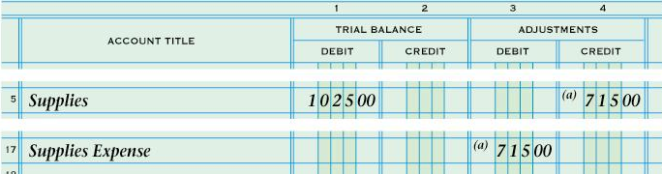
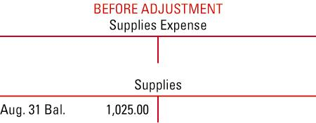
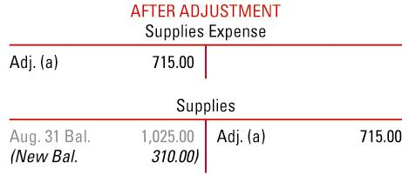
SUPPLIES ADJUSTMENT ON A WORK SHEET
page 158
2
3
1
1. Write the debit amount.
2. Write the credit amount.
3. Label the two parts of this adjustment.

Slide 13
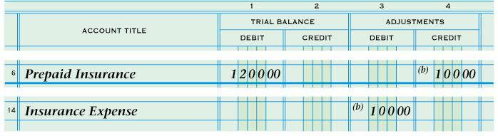
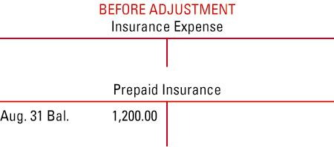
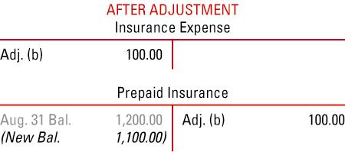
PREPAID INSURANCE ADJUSTMENT ON A WORK SHEET
page 159
2
3
1
1. Write the debit amount.
2. Write the credit amount.
3. Label the two parts of this adjustment.

Slide 14
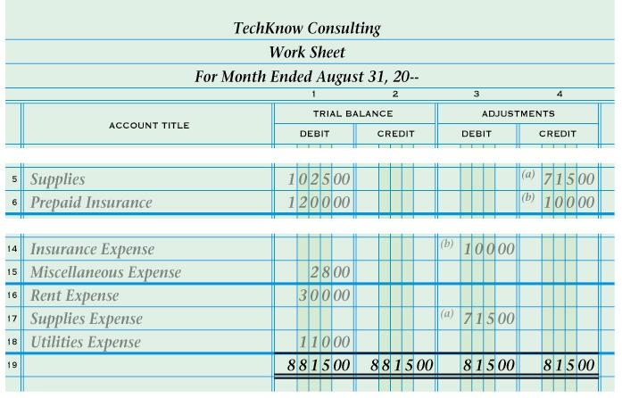
PROVING THE ADJUSTMENTS COLUMNS OF A WORK SHEET
page 160
1
2
1. Rule a single line.
2. Add both the Adjustments Debit and Credit columns. Write each column’s total.
3
3. Rule double lines.

Slide 15
PREPARING A WORK SHEET
page 160 C
1. Write the heading.
2. Record the trial balance.
3. Record the supplies adjustment.
4. Record the prepaid insurance adjustment.
5. Prove the Adjustments columns.
6. Extend all balance sheet account balances.
7. Extend all income statement account balances.
8. Calculate and record the net income (or net loss).
9. Total and rule the Income Statement and Balance Sheet columns.

Slide 16
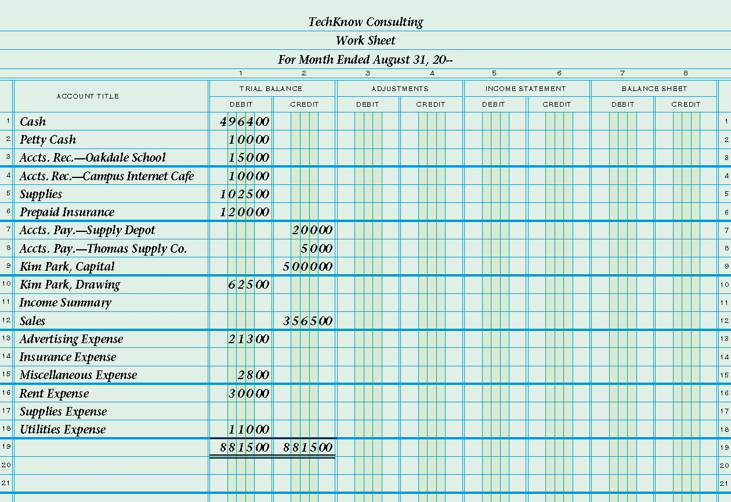

Slide 17
1

Slide 18
1
2
496400
10000
15000
496400
10000
15000
6
10000
102500
120000
10000
31000
110000
^{(a)} 71500
^{(b)} 10000
20000
5000
500000
20000
5000
500000
3
62500
4
62500
356500
356500
21300
21300
^{(b)} 10000
10000
7
2800
30000
2800
30000
^{(a)} 71500
5
71500
11000
11000
881500
881500
81500
81500
146600
356500
734900
525000
Net Income
8
209900
209900
9
356500
356500
734900
734900

Slide 19
TERM REVIEW
adjustments

Slide 20
work together 6-2 on your own 6-2
Open the 6-1 thru 6-3 worksheet previously completed in Lesson 6-1
work together will be started in class
adjustments debits and credits = 278.00
Complete on your own
adjustments debits and credits = 366.00
Keep for lesson 6-3.

Slide 21

Learning Objectives
LO5 Prepare the Balance Sheet and Income Statement columns of a work sheet.
LO6 Total and rule the work sheet.
LO7 Apply the steps for finding errors on a work sheet.
© 2014 Cengage Learning. All Rights Reserved.

Slide 22
Extending Balance Sheet Account Balances on a Work Sheet
Lesson 6-3
LO5
A financial statement that reports the value of a business’s assets, liabilities, and owner’s equity on a specific date is called a balance sheet.

Slide 23
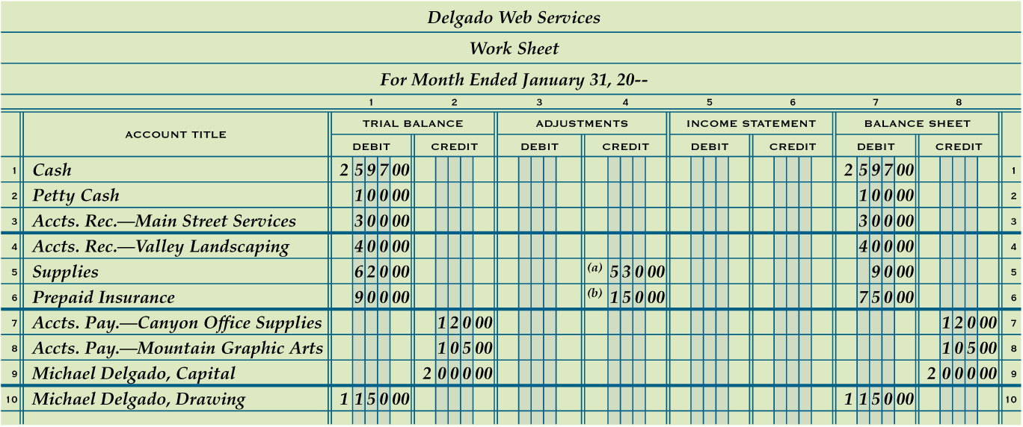
Extending Balance Sheet Account Balances on a Work Sheet
Lesson 6-3
LO5
Debit Balances without Adjustments
1
Debit Balances with Adjustments
2
Credit Balances without Adjustments
3

Slide 24
Extending Income Statement Account Balances on a Work Sheet
Lesson 6-3
LO5
A financial statement showing the revenue and expenses for a fiscal period is called an income statement.

Slide 25
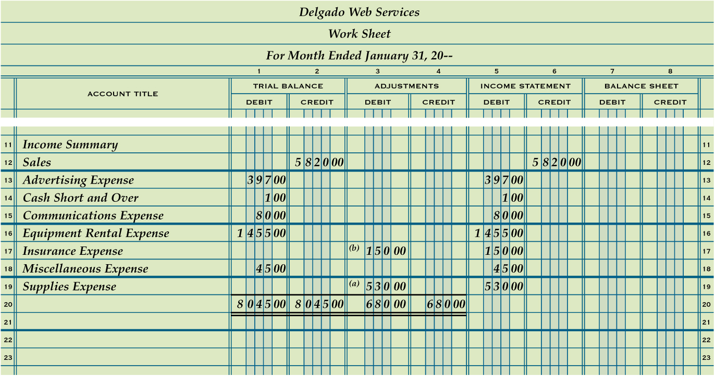
Extending Income Statement Account Balances on a Work Sheet
Lesson 6-3
LO5
Sales Balance
1
Expense Balances with Adjustments
3
2
Expense Balances without Adjustments

Slide 26
Recording Net Income and Totaling and Ruling a Work Sheet
Lesson 6-3
LO6
The difference between total revenue and total expenses when total revenue is greater is called net income.

Slide 27
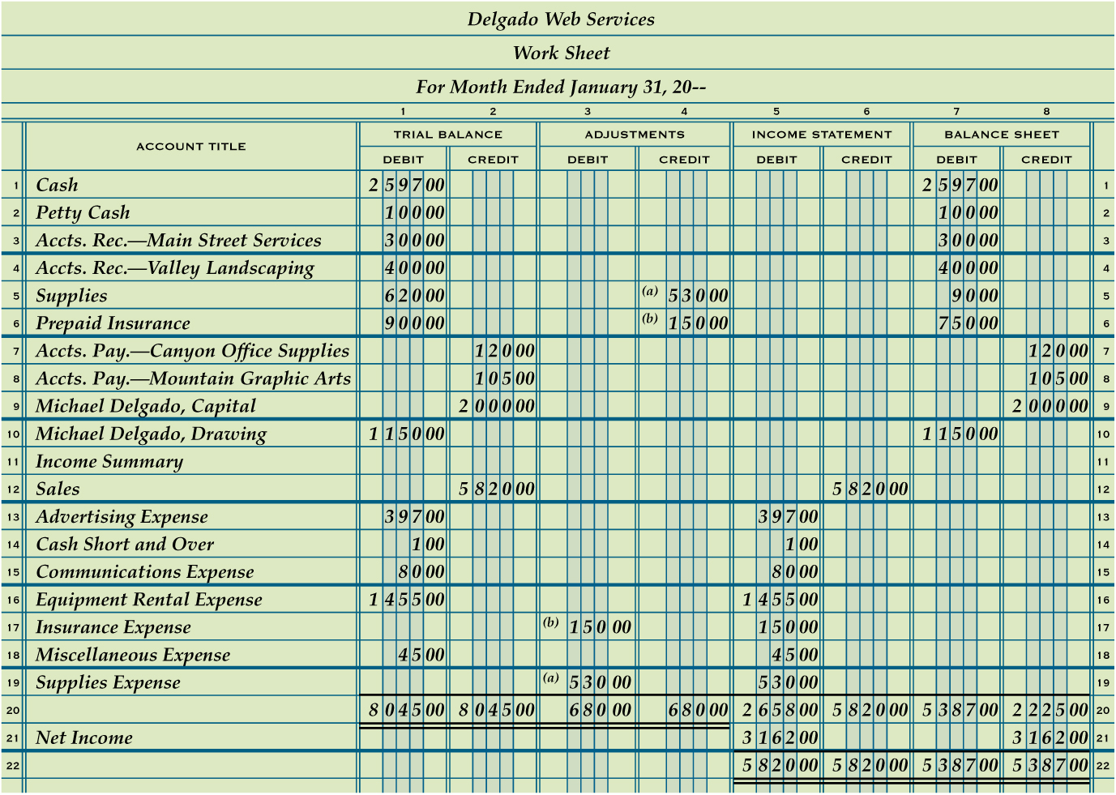
Recording Net Income and Totaling and Ruling a Work Sheet
Lesson 6-3
LO6
1
Single Rule
2
Totals
5
Single Rule
6
Totals
Net Income
3
Double Rule
7
4
Extend Net Income

Slide 28
Calculating and Recording a Net Loss on a Work Sheet
Lesson 6-3
LO6
The difference between total revenue and total expenses when total expenses are greater is called a net loss.

Slide 29
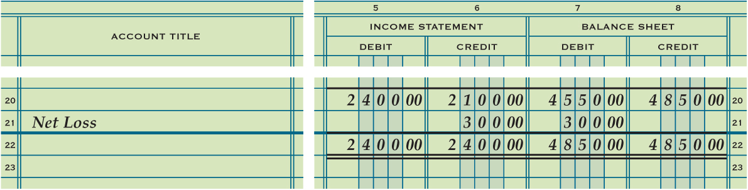
Calculating and Recording a Net Loss on a Work Sheet
Lesson 6-3
LO6
1
Single Rule
Net Loss
3
4
Extend Net Loss
Totals
2

Slide 30
Finding and Correcting Errors on the Work Sheet
Lesson 6-3
LO7
Several different kinds of errors may be made when preparing a work sheet.
Three examples
There may be errors in the accounting records.
There may be errors in calculations.
An amount may be entered in the wrong column.

Slide 31
Lesson 6-3 Audit Your Understanding
Lesson 6-3
1. In which Balance Sheet column is net income recorded on the work sheet?
ANSWER
Balance Sheet Credit column

Slide 32
Lesson 6-3 Audit Your Understanding
Lesson 6-3
2. In which Balance Sheet column is net loss recorded on the work sheet?
ANSWER
Balance Sheet Debit column

Slide 33
Lesson 6-3 Audit Your Understanding
Lesson 6-3
3. What is the first step in checking for arithmetic errors when two column totals are not in balance?
ANSWER
Subtract the smaller total from the larger total to find the difference.

Slide 34
Lesson 6-3 Audit Your Understanding
Lesson 6-3
4. What is one way to check for an error caused by transposed numbers?
ANSWER
The difference between two column totals can be divided evenly by 9.

Slide 35
Lesson 6-3 Audit Your Understanding
Lesson 6-3
5. What term is used to describe an error that occurs when numbers are moved to the right or left in an amount column?
ANSWER
Slide

Slide 36
work together 6-3 on your own 6-3
Open the 6-1 thru 6-3 worksheet previously completed in Lessons 6-1 & 6-2
work together will be started in class
Complete on your own
Submit as indicated by Instructor

Slide 37

Learning Objective
LO8 Journalize and post the adjusting entries for supplies and prepaid insurance.
© 2014 Cengage Learning. All Rights Reserved.

Slide 38
Adjusting Entry for Supplies
Lesson 6-4
LO8
Journal entries recorded to update general ledger accounts at the end of a fiscal period are called adjusting entries.

Slide 39
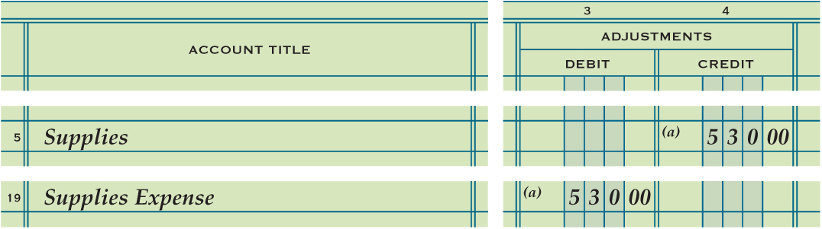
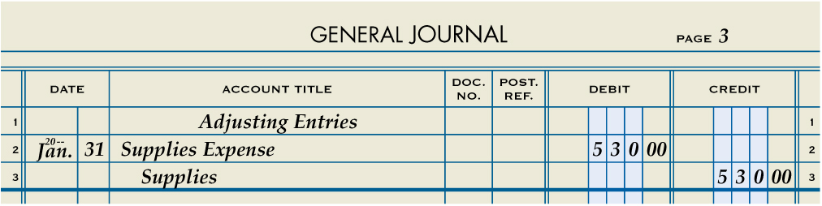
Adjusting Entry for Supplies
Lesson 6-4
LO8
Supplies Expense
Adj. (a) 530.00
Supplies
Jan. 31 Bal. 620.00
Adj. (a) 530.00
(New Bal. 90.00)
1
Heading
3
Debit
2
Date
4
Credit

Slide 40
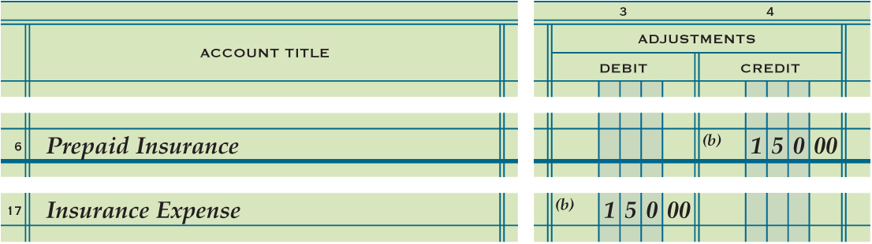
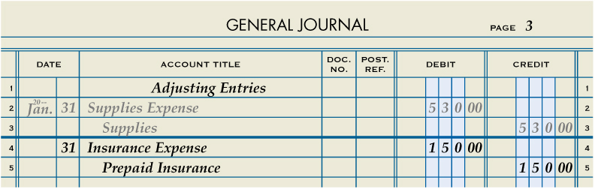
Adjusting Entry for Prepaid Insurance
Lesson 6-4
LO8
Insurance Expense
Adj. (b) 150.00
Prepaid Insurance
Jan. 31 Bal. 900.00
Adj. (b) 150.00
(New Bal. 750.00)
1
Heading
3
Debit
2
Date
4
Credit

Slide 41
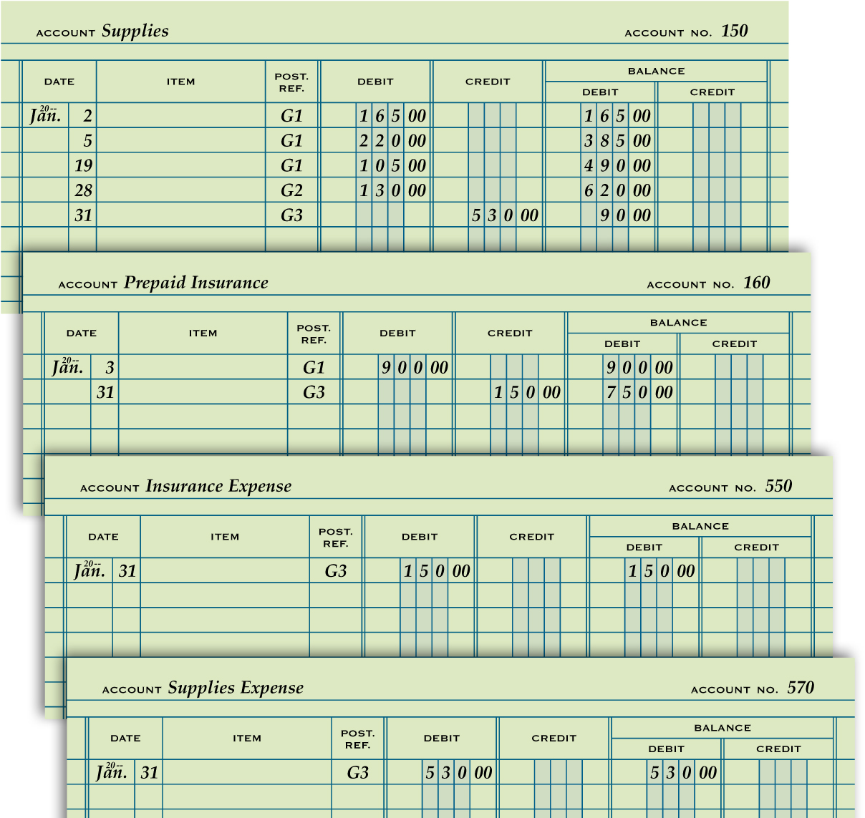
Partial Ledger Accounts after Posting Adjusting Entries
Lesson 6-4
LO8

Slide 42
Lesson 6-4 Audit Your Understanding
Lesson 6-4
1. Why are adjusting entries journalized?
ANSWER
To update general ledger accounts at the end of a fiscal period

Slide 43
Lesson 6-4 Audit Your Understanding
Lesson 6-4
2. Where is the information obtained to journalize adjusting entries?
ANSWER
Adjustments column

Slide 44
Lesson 6-4 Audit Your Understanding
Lesson 6-4
3. Which accounts are increased from zero balances after adjusting entries for supplies and prepaid insurance are journalized and posted?
ANSWER
Supplies Expense
Insurance Expense

Slide 45
Work Together 6-4 On You Own 6-4
Work Together
Model
6-4
Refer to 6-1 thru 6-3.xls
On Your Own
6-4
6-1 thru 6-3.xls

Slide 46
Application Problems
6-1 Application Problem
6-2 Application Problem
6-3 Application Problem
Self-Correcting Excel
1 File - P 6-1 thru P6-3.xls

Slide 47
Application Problems
6-4 Application Problem
Excel
6 Mastery Problem
Peachtree

Slide 48
Unit 6 Assessment
Unit 6 Review (ExamView)
90 % or Greater
5 Point Bonus on Unit 1 Concept Quiz (20% Bonus)
Unit 6 Part 1 Quiz (ExamView)
Concepts – 25 Questions (25 Points)
Unit 6 Part 2 Quiz (Excel)
Skills (30 Points)

